Slide 1
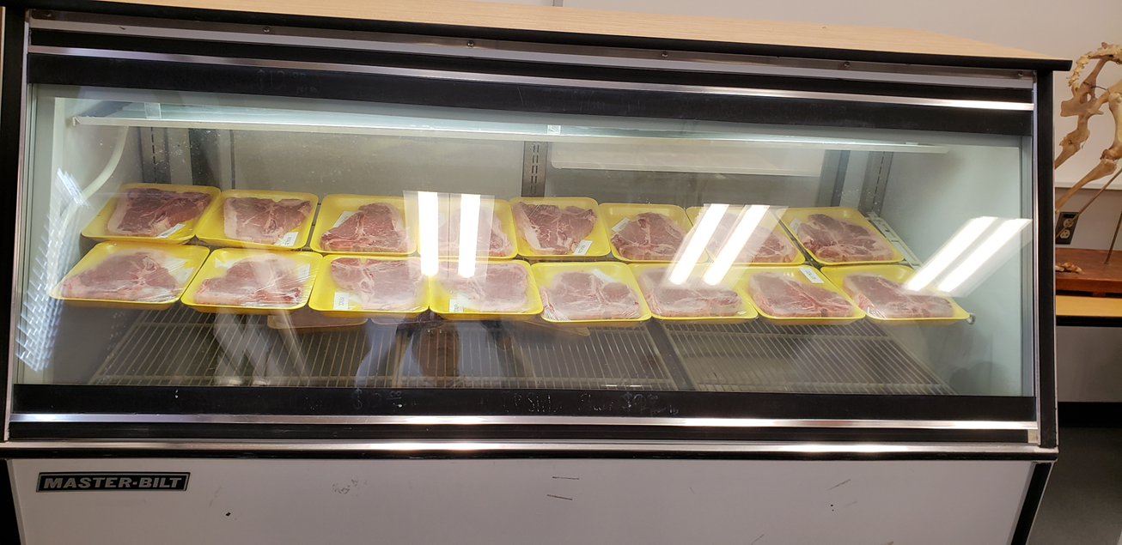
Figure 1. Display of beef steaks that were fabricated using conventional and wet cuts.

Slide 2
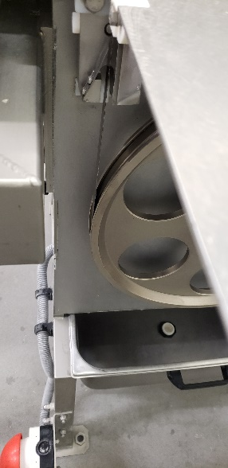
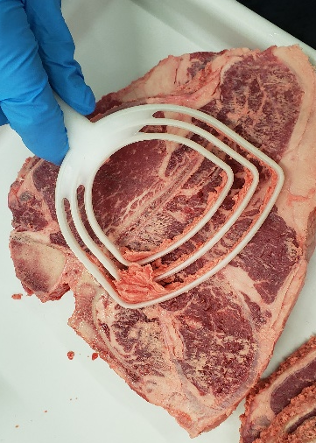
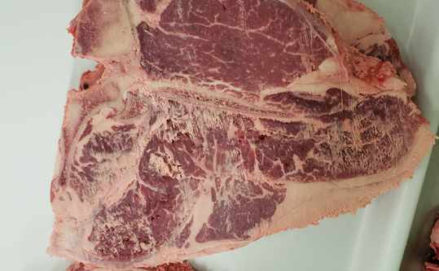
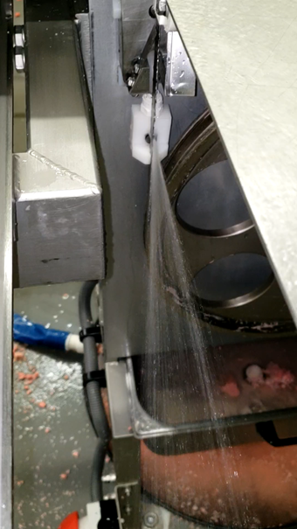
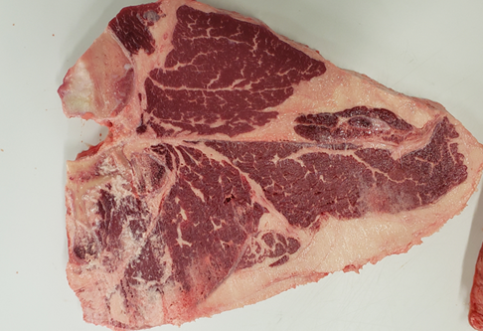
1a
1b
1c
2b
2b
Figure 2. Visual appearance of beef steaks that were fabricated using traditional cut (a) and wet cut (b)
1a - Conventional band saw; 1b - steak appearance after conventional cut; 1c – scrapping off from steak
2a - Nozzle band saw; 2b - steak appearance after conventional cut with water jet.

Slide 3
a
Fabrication Time (sec)
b
Conventional cut
Wet cut
Figure 3. Fabrication time¹ for beef loin steaks using conventional cut and wet cut
¹Number of observation, n = 6

Slide 4
Conventional cut
Wet cut
1a
1b
2a
2b
Figure 4. Scanning electron microscope image (1,000 x magnification) of
beef loin steaks that were fabricated using conventional cut (a) and wet cut (b)
1a, 1b – Steak edge
1a, 2a – Steak center

Slide 5
Table 1. Comparison of yield, pH, TBARS, and color values of beef loin and tenderloin during 12-days of storage
after fabrication using conventional cut and wet cut
Parameter |  | Storage day 0-day 3-day 6-day 9-day 12-day |  |  |  |  | Cutting method conventional cut wet cut
Yield (%) |  | 100±0.00ª | 99.00±0.16ª | 98.48±0.16^{ab} | 97.75±0.16^{bc} | 97.20±0.16^{c} | 98.11±0.08 | 98.10±0.08
pH | Loin | 5.59±0.05ª | 5.51±0.05^{b} | 5.57±0.05ª | 5.46±0.05^{b} | 5.45±0.05^{b} | 5.52±0.02 | 5.52±0.02
 | Tenderloin | 5.51±0.05ª | 5.53±0.05ª | 5.51±0.05ª | 5.39±0.05^{b} | 5.41±0.05^{b} | 5.52±0.05ª | 5.42±0.05^{b}
TBARS | Loin | 0.19±0.06^{c} | 0.27±0.06^{c} | 0.51±0.06^{b} | 0.93±0.06ª | 1.02±0.06ª | 0.56±0.04 | 0.61±0.04
 | Tenderloin | 0.27±0.07^{d} | 0.26±0.07^{d} | 0.69±0.07^{c} | 1.00±0.07^{b} | 1.18±0.07ª | 0.66±0.04 | 0.70±0.04
Brightness (L*) | Loin | 55.71±1.52ª | 49.82±1.52^{c} | 48.34±1.52^{c} | 48.16±1.52^{c} | 51.34±1.52^{b} | 51.85±1.16ª | 49.49±1.16^{b}
 | Tenderloin | 53.38±1.33ª | 51.96±1.33^{ab} | 50.06±1.33^{b} | 50.46±1.33^{b} | 52.22±1.33ª | 52.98±0.79 | 50.25±0.79
Redness (a*) | Loin | 17.52±1.33ª | 17.60±1.33ª | 16.09±1.33ª | 15.04±1.33ª | 10.03±1.33^{b} | 15.32±0.96 | 15.19±0.96
 | Tenderloin | 16.95±1.35^{ab} | 18.32±1.35ª | 14.78±1.35^{b} | 11.14±1.35^{c} | 7.81±1.35^{d} | 13.85±0.94 | 13.75±0.94
Yellowness (b*) | Loin | 9.64±0.88^{ab} | 10.59±0.88ª | 9.56±0.88^{ab} | 9.71±0.88ª | 7.50±0.88^{b} | 9.22±0.68 | 9.58±0.68
 | Tenderloin | 8.14±0.65^{bc} | 9.60±0.65ª | 9.77±0.65ª | 8.45±0.65^{b} | 7.07±0.65^{c} | 8.28±0.32 | 8.93±0.32
^{a–b}Means within a raw with unlike superscripts are different (P < 0.05).
¹Skin treatments: same as in Figure 1 (number of observations in each chilling, n = 9).

Slide 6
MAB (log CFU/surface)
a
ab
c
bc
c
Days
Figure 5. Growth of mesophilic aerobic bacteria (MAB) on beef loin steaks
during storage for 12 days after fabrication by dry cut and wet cut
Chilling conditions as in Figure 1.
¹Number of observation, n = 12

Slide 7
a
Coliform (log CFU/surface)
b
c
c
c
Days
Figure 6. Growth of coliform bacteria on beef loin steaks during storage for
12 days after fabrication by dry cut and wet cut
Chilling conditions as in Figure 1.
¹Number of observation, n = 12

Slide 8

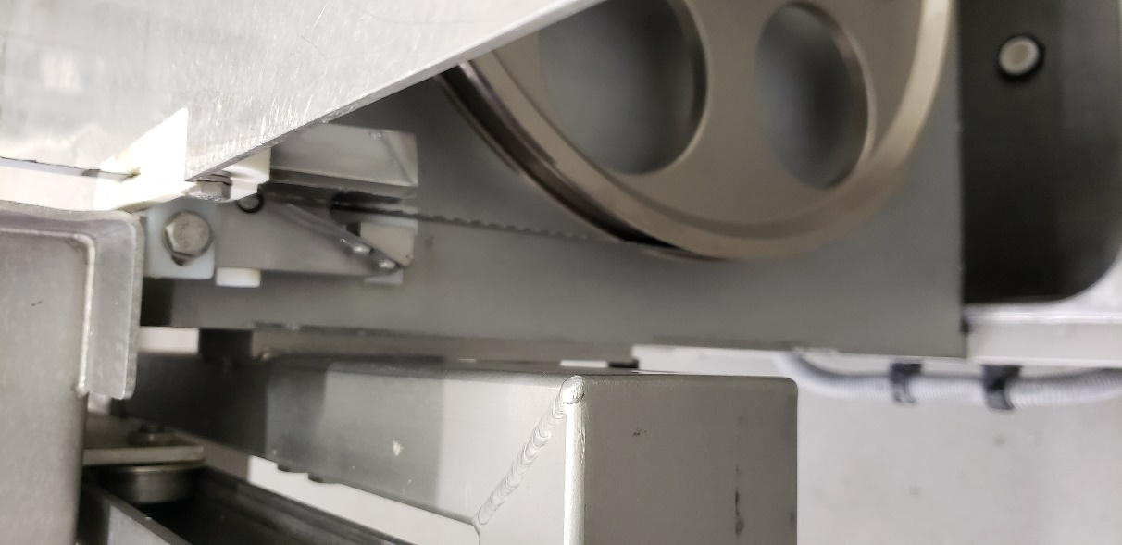
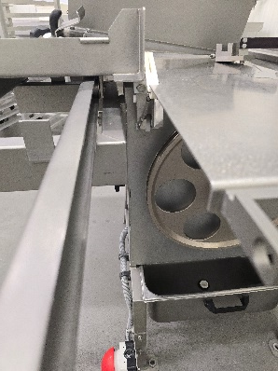
Figure 1. Visual appearance of beef steaks that were fabricated using dry cut (a) and wet cut (b)

Slide 9
Edge of steak
Center of steak
Dry cut
Wet cut
Figure 2. Visual appearance of beef steak surfaces that are
cut using dry saw (a) and wet saw (b)
¹Skin treatments: same as in Figure 1 (number of observations in each chilling, n = 9).

Slide 10
a
c
c
b
c
Brightness (L*)
Muscle color ( L*, a*, b*)
a
a
a
a
a
ab
b
ab
a
Redness (a*)
b
Yellowness (b*)
Figure 2. Comparison of muscle color (L*, a*, b*) of beef loins during storage after
fabrication
Chilling conditions as in Figure 1.
¹Number of observation, n = 12

Slide 11
a
ab
b
a
b
Brightness (L*)
ab
a
b
c
bc
d
a
a
b
c
Figure 2. Comparison of muscle brightness (L*) of beef tenderloins during storage
after fabricating by dry cut and wet cut
Chilling conditions as in Figure 1.
¹Number of observation, n = 12

Slide 12
Skin-on
Skin-off
b
a
b
a
Figure 4. Carcass chilling profile for the leg SM¹ and loin LL¹ muscles in skin-on and skin-off
carcasses²
^{a–b}Means within a same muscle with unlike superscripts are different (P < 0.05).
¹SM: semimembranosus; LM: longissimus lumborum , n = 9).
²Skin treatments: same as in Figure 1 (number of observations in each chilling, n = 9).

Slide 13
Figure 3. Fabrication of goat carcass to four primal cuts

Slide 14
Table 1. Live weight, carcass weight, slaughter time, and fabrication time of skin-on and skin off goat carcasses
Parameter/Carcass¹ | Skin-on | Skin-off | Skin-off-late
Live weight (kg) | 37.8±1.24ª | 36.4±1.26ª | 34.3±1.33ª
Hot carcass weight (kg) | 22.06±0.81ª | 18.70±0.81^{b} | 20.47±0.85^{ab}
Cold carcass weight (kg) | 20.61±0.81ª | 17.46±0.81^{b} | 18.80±0.85^{ab}
Slaughter time from stun to evisceration (min) | 56.3±6.13ª | 62.9±6.13ª | 49.9±6.46ª
Fabrication time (min) | 8.9±2.03^{b} | 9.9±1.81^{b} | 18.0±1.91ª
Total processing time (min) | 66.02±2.31ª | 72.8±2.31ª | 67.9±2.31ª
^{a–b}Means within a raw with unlike superscripts are different (P < 0.05).
¹Skin treatments: same as in Figure 1 (number of observations in each chilling, n = 9).

Slide 15
Table 2. Carcass chilling yield, dressing yield, primal cut yield, and
fabrication yield of skin-on and skin off goat carcasses
Parameter/Carcass¹ | Skin-on | Skin-off | Skin-off-late
Dressing yield (%) | 59.38±4.26ª | 51.96±4.26^{b} | 55.51±4.27ª
Neck yield (%) | 5.91±0.59ª | 5.25±0.59^{ab} | 4.80±0.59^{b}
Breast yield (%) | 11.01±2.74ª | 10.78±2.75ª | 9.65±2.76ª
Shoulder yield (%) | 20.15±1.50ª | 21.53±1.50ª | 21.67±1.51ª
Rack yield (%) | 12.57±0.70ª | 12.67±0.70ª | 12.43±0.71ª
Loin yield (%) | 10.66±0.35ª | 11.06±0.35ª | 9.82±0.36^{b}
Leg yield (%) | 27.97±1.93ª | 28.67±1.93ª | 28.84±1.93ª
Shank yield (%) | 7.97±1.84ª | 8.43±1.84ª | 8.17±1.85ª
Chilling yield (%) | 95.0±0.86ª | 94.8±0.81ª | 94.4±0.81ª
Fabrication yield (%) | 85.50±6.87ª | 85.92±6.86ª | 77.52±6.84^{b}
^{a–b}Means within a raw with unlike superscripts are different (P < 0.05).
¹Skin treatments: same as in Figure 1 (number of observations in each chilling, n = 9).

Slide 16
Stunning and bleeding of 27 goats
Skin-on processing¹
from skin-on goats
(9 skin-on goats)
Skin-off processing²
from skin-off goats
(9 skin-off goats)
Skin-off-late processing³
from skin-off-late goats
(9 skin-modified goats)
Scalding, deharing, singing, and evisceration
Deskinning and evisceration
Scalding, deharing, singing, and evisceration
Chilling of skin-on goats
Chilling of skin-off goats
Chilling of skin-on goats
Fabrication for skin-on meat
Fabrication for skin-off meat
Fabrication for skin-off meat
after skin elimination
Figure 1. Preparation of traditional meat, ethnic meat, and modified meat from skin off and skin-on carcasses
¹Skin-on: Skin not eliminated
²Skin-off: Skin eliminated after bleeding
³Skin-off-late: Skin eliminated after chilling

Slide 17
_{a}
_{a}
_{b}
_{b}
Figure 5. pH profile of SM¹ and LL¹ muscles
^{a–b}Means within a same postmortem hour with unlike superscripts are different (P < 0.05).
¹SM: semimembranosus; LM: longissimus lumborum , n = 9).

Slide 18
_{a}
_{ab}
_{b}
_{a}
_{ab}
_{b}
Figure 6. pH profile of skin-on, skin-off, and skin-on-late muscles¹
^{a–b}Means within a same postmortem hour with unlike superscripts are different (P < 0.05).
¹Skin treatments: same as in Figure 1 (number of observations in each chilling, n = 9).

Slide 19
Table 3. Muscle pH, sarcomere length, and shear force of skin-on and skin off goat carcasses
Parameter/Carcass¹ | SM² | LL² |  | Skin-on | Skin-off | Skin-off-late
Sarcomere Length (µm) | 2.04±0.07ª | 1.90±0.07^{b} |  | 1.99±0.07ª | 1.92±0.08ª | 2.01±0.08ª
WBSF (kg) | 4.66±0.55ª | 4.17±0.55ª |  | 3.99±0.57^{b} | 5.30±0.59ª | 3.95±0.58^{b}
^{a–b}Means within a raw with unlike superscripts are different (P < 0.05).
¹Skin treatments: same as in Figure 1 (number of observations in each chilling, n = 9).
²SM: semimembranosus; LM: longissimus lumborum , n = 9).

Slide 20
Table 4. Collagen content, and cooking yield of skin-on and skin off goat carcasses
Parameter/Carcass¹ | Skin-on SM² | Skin-off SM | Skin-off-late SM | Skin-on LL² | Skin-off LL | Skin-off-late LL
Collagen Content (mg/g) | 6.77±3.50^{cb} | 4.15±3.58^{cb} | 1.85±3.59^{c} | 25.16±3.49ª | 8.79±3.58^{cb} | 10.55±3.59^{b}
Cooking Yield (%) | 88.09±1.58ª | 84.17±1.62^{b} | 81.28±1.64^{b} | 88.50±1.59ª | 89.5±1.62ª | 88.07±1.64ª
^{a–c}Means within a raw with unlike superscripts are different (P < 0.05).
¹Skin treatments: same as in Figure 1 (number of observations in each chilling, n = 9).
²SM: semimembranosus; LM: longissimus lumborum , n = 9).

Slide 21
Table 5. Comparison of color on SM and LL muscles
Parameter/Carcass¹ | SM² | LL² |  | Skin-on | Skin-off | Skin-off-late
L* | 48.58±0.60ª | 46.68±0.60ª |  | 47.86±0.63ª | 46.82±0.65^{b} | 48.22±0.64ª
a* | 12.95±0.24ª | 11.62±0.24^{b} |  | 12.17±0.29ª | 12.01±0.29ª | 12.69±0.31ª
b* | 5.79±0.34ª | 4.97±0.34^{b} |  | 5.45±0.36ª | 5.09±0.37ª | 5.59±0.37ª
^{a–c}Means within a raw with unlike superscripts are different (P < 0.05).
¹Skin treatments: same as in Figure 1 (number of observations in each chilling, n = 9).
²SM: semimembranosus; LM: longissimus lumborum , n = 9).

